Slide 1
Intelligent Document Assistant
Comparative Insights and Model Effectiveness

Slide 2
Objective
Evaluate and compare summarization models on the XSum and CNN datasets for Article and Legal Document Summarization

Slide 3
Business Usecase
Problem: Scholors and Legal professionals need to review lengthy contracts, Articles, and documents.
Solution: Use summarization to extract key clauses, terms, or case insights.
Impact: Saves time and reduces errors, aiding faster legal review and compliance.

Slide 4
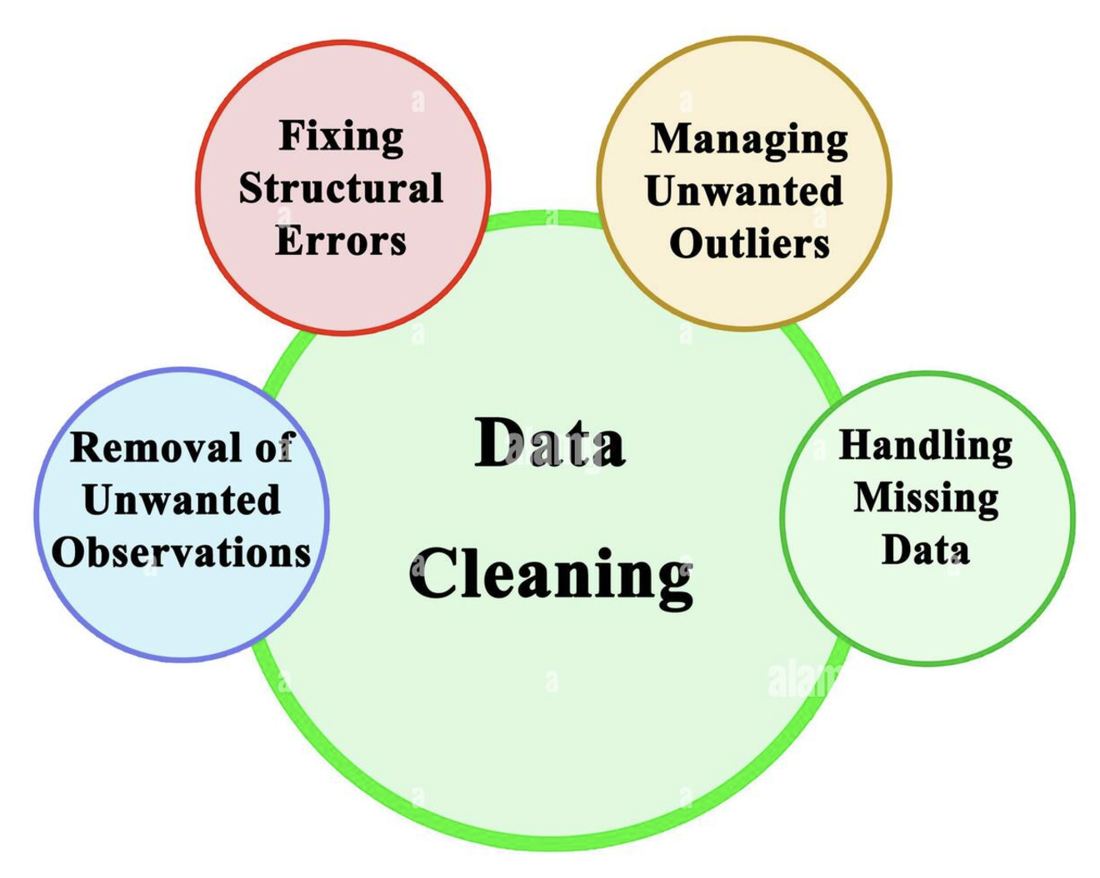
Datasets
CNN and Xsum

Slide 5

Dataset Overview
Xsum:
2.3 Million documents
Training: 8000 documents
Testing: 2000 documents
CNN:
2.8 Million documents
Training: 8000 documents
Testing: 2000 documents

Slide 6
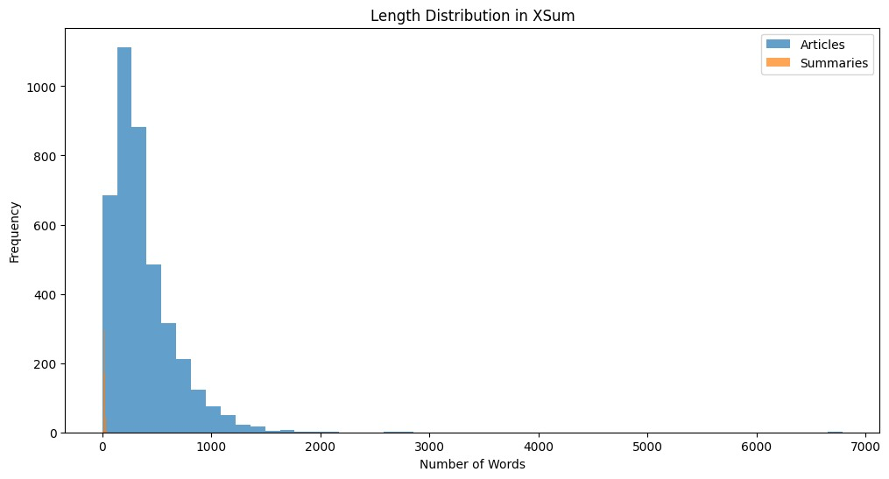
Xsum Length Distribution
Count of Words in Articles:
Min: 0
Max: 6789
Avg: 299.02
Count of Words in Summaries:
Min: 1
Max: 52
Avg: 5.21

Slide 7
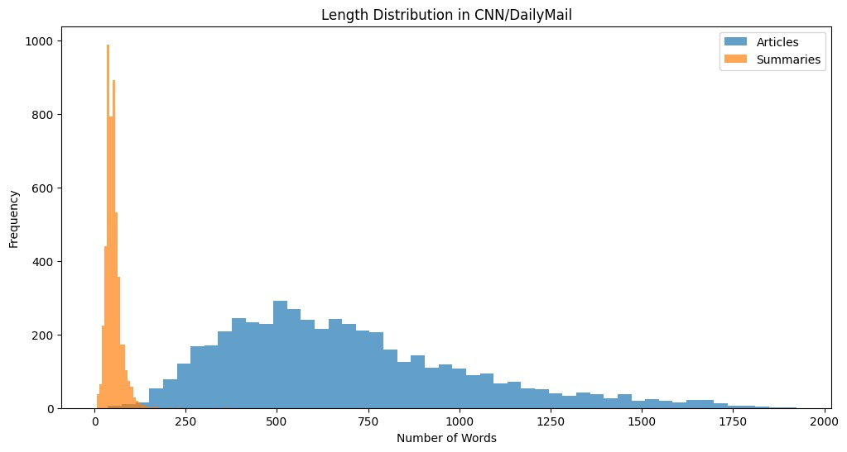
CNN Length Distribution
Count of Words in Articles:
Min: 37
Max: 1924
Avg: 334.26
Count of Words in Summaries:
Min: 6
Max: 362
Avg: 20.52

Slide 8
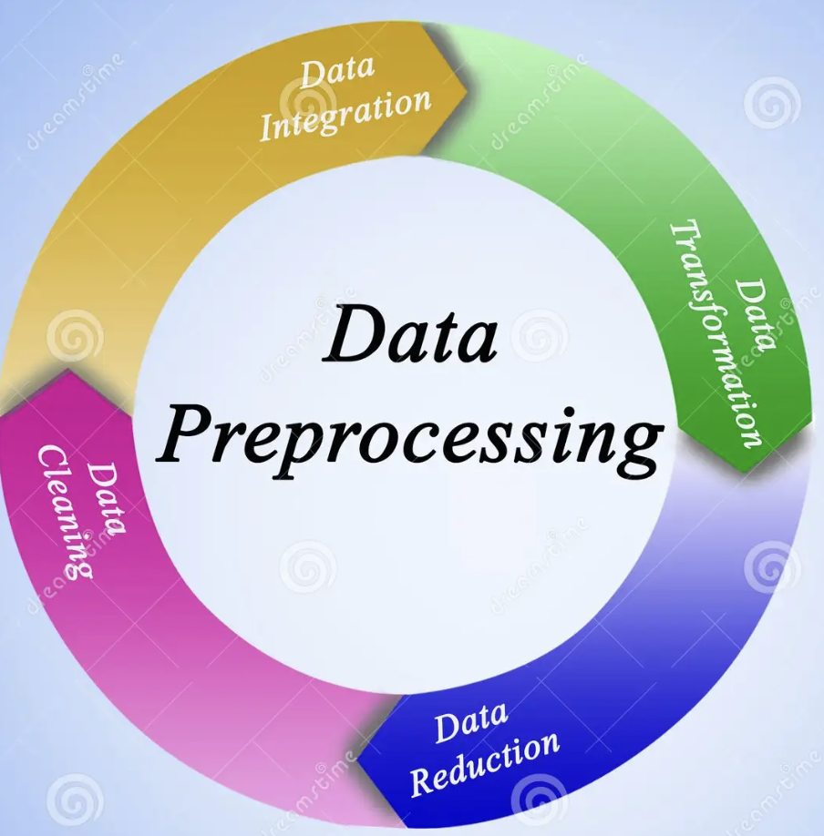
Data Preprocessing
Removed white spaces
Sampled to 10,000 documents
Removing Stopwords, tokenization

Slide 9

Bart Model
Trained on diverse datasets for both abstractive and extractive tasks.
Strong performance on summarization benchmarks like XSum and CNN.
Flexible architecture: suitable for both short and long-form text summarization.

Slide 10
Pegasus and T5
Pegasus: Designed for abstractive summarization but requires substantial computational resources for training.
T5: A text-to-text model with summarization capabilities, though it demands extensive memory and fine-tuning time.
Limitations: Pegasus model is not tested due to challenges in loading and training on available hardware.

Slide 11
Named Entity Recognitions with Text summarization
Contextual Insights: Summarization provides a high-level overview, while NER extracts entities like names, dates, and locations.
Enhanced Understanding: Helps identify key actors, timelines, and organizations within summarized content.
SpaCy: Pre-trained pipelines for general-purpose NER.

Slide 12

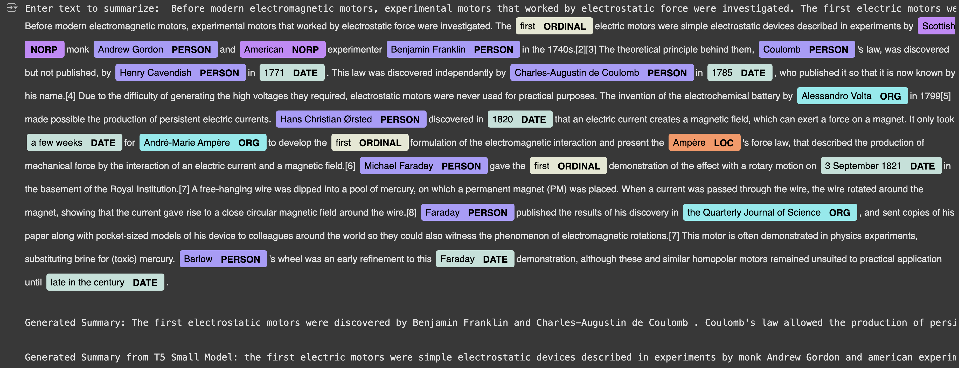
Output

Slide 13

Evaluation
ROUGE (Recall-Oriented Understudy for Gisting Evaluation) measures the overlap of n-grams, word sequences, or longest common subsequences between generated and reference summaries.
Higher ROUGE scores indicate better alignment with human-generated summaries, reflecting the model's quality.
ROUGE-1: Unigram overlap ROUGE-2: Bigram overlap
ROUGE-L: Longest common subsequence
These ROUGE scores indicate the model effectively captures key words, phrases, and sequence structures, performing competitively in abstractive summarization tasks.

Slide 14

Results and Analysis
Bart ROUGE Scores:
Rouge1: 0.329 Rouge2: 0.123 Rouge-L: 0.242
T5 ROUGE Scores:
Rouge1: 0.186 Rouge2: 0.0125 Rouge-L: 0.127
Conclusion:
Bart outperforms T5, with higher ROUGE scores indicating better overlap and alignment with reference summaries.

Slide 15
Challenges Encountered
Dataset-Specific Issues:
XSum: Factual consistency is challenging.
CNN: Extractive summaries.
General Challenges:
Handling large data.
Balancing abstraction and factuality.

Slide 16
Future Improvements
Reinforcement learning
Experiment GPT variants
Explore multi-document summarization

Slide 17

Thank you

